Slide 1
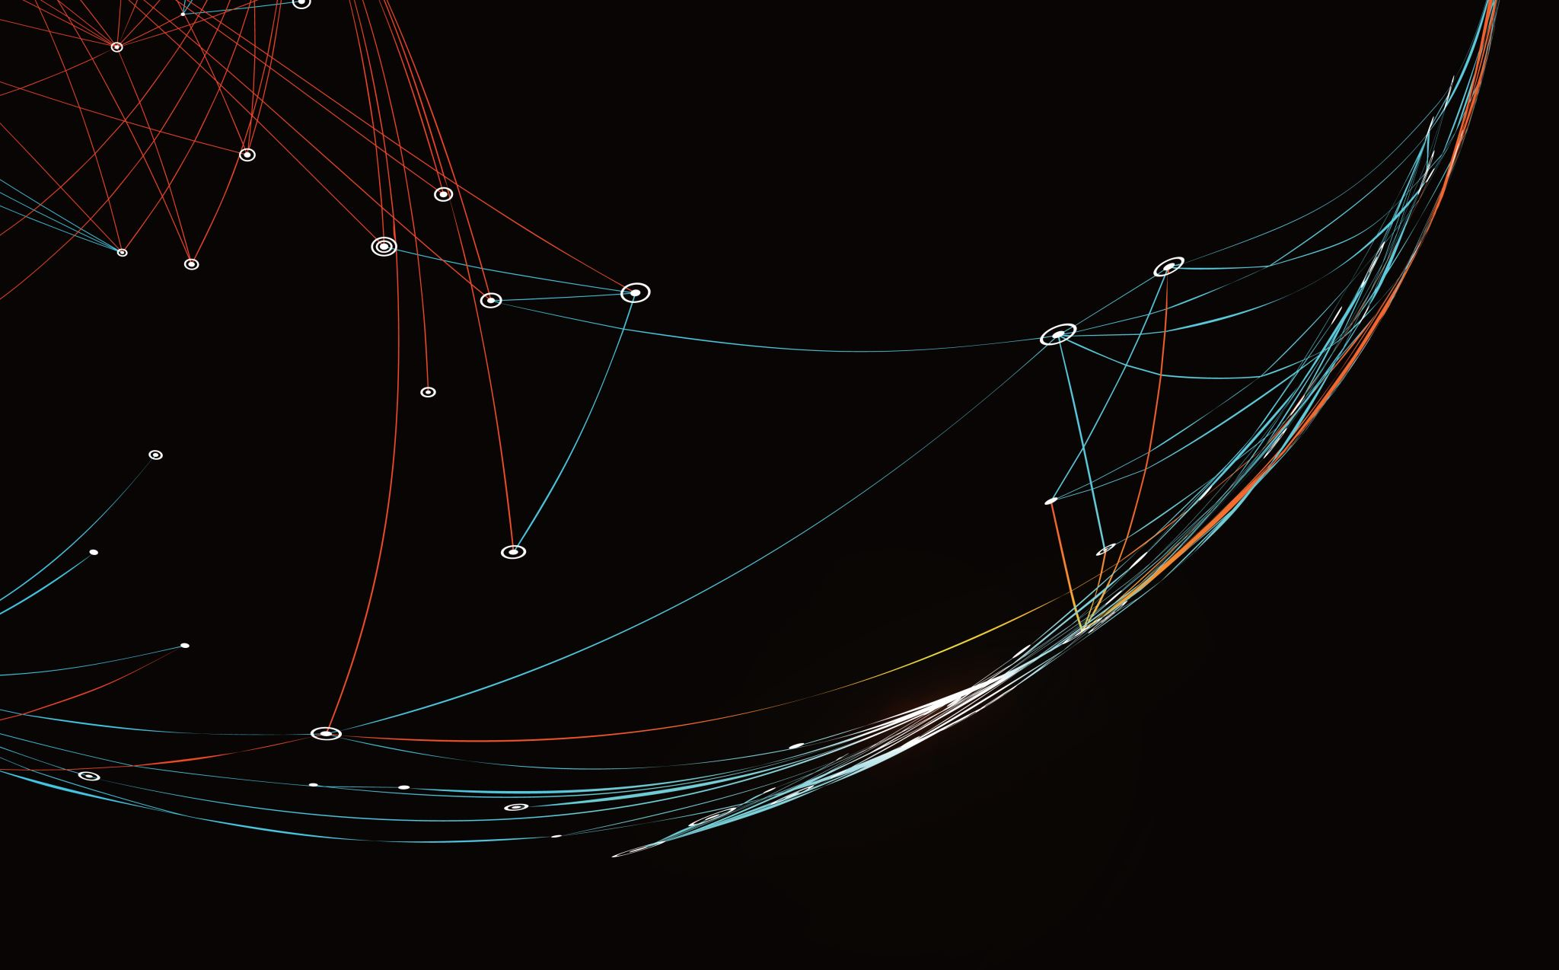

Comparison of KNN and Decision Tree Classification Algorithms for Bluetooth Fingerprinting using RSSI
Kristian James p. Guinto – s3826723
Rmit university
Notes:
This presentation will be about comparing the performance of KNN and Decision Tree when used as algorithms for Bluetooth Fingerprinting using RSSi

Slide 2
Introduction
Bluetooth Fingerprinting is an indoor positioning technique that uses Bluetooth signal characteristics to determine a receivers location. Received Signal Strength Indicator (RSSI) from different beacons are mapped to a space creating unique fingerprints for different locations in the space.
K Nearest Neighbors (KNN) and Decision Tree are two supervised-learning algorithms used for classification problems. K Nearest Neighbors makes classification by analyzing the classes of the nearest neighbors of the features of an unknown data. On the other hand, perform classification by creating a tree structure made of decision nodes that split the data to create a terminal node that represents the different classes from the dataset.
Indoor positioning can be solved using classification algorithms by mapping the space into a grid and creating labels to represent all the possible positions in the space.
Notes:
Bluetooth fingerprinting is an indoor position technique that uses *RSSI* to create unique fingerprints that identify a location in space. This task was completed using classification algorithm by dividing the space into a grid and using the grid labels as the different classes.

Slide 3
Problem Statement
This project aims to compare the performance of KNN and Decision Tree in performing Bluetooth fingerprinting using RSSI as features.
Accuracy and distance error, i.e. distance between predicted label and actual label, were the metrics used to validate and compare the performance of the two models.
Notes:
So the goal for this project is to see which algorithm performs better for Bluetooth fingerprinting. Accuracy will be the primary measure of performance while distance error will be considered as a secondary metric.

Slide 4
Bluetooth Low-Energy (BLE) RSSI Dataset
The dataset used for this project contains 1420 set of RSSI readings gathered from thirteen (13) iBeacons deployed in a library setup.
The dataset was also labelled with the location for each reading and a timestamp when the reading was made.
The measurements were made using an iPhone 6s with each reading 2 seconds apart and were conducted on six different dates.
This dataset was made by Mehdi Mohammadi and Ala Al-Fuqaha both from the computer science department of Western Michigan University and was downloaded from UCI machine learning repository. [1]
[1] M. Mohammadi and A. Al-Fuqaha and M. Guizani and J. S. Oh, BLE RSSI Dataset for Indoor localization and Navigation Data Set, UCI Machine Learning Repository, 2017, [online]. Available: https://archive.ics.uci.edu/ml/datasets/BLE+RSSI+Dataset+for+Indoor+localization+and+Navigation
Notes:
The dataset that was used is the Bluetooth Low-Energy dataset from the UCI machine learning repository. This dataset contains RSSI measurements from 13 beacons deployed in a library as well as location labels and timestamp.

Slide 5
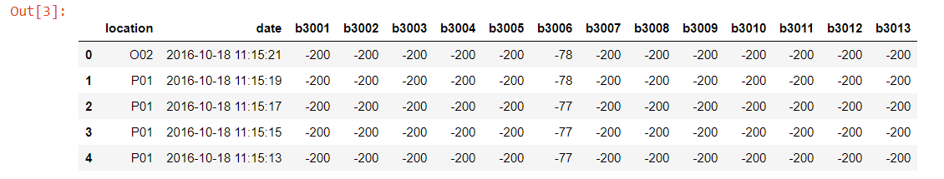
Bluetooth Low-Energy (BLE) RSSI Dataset
The RSSI have negative values where a higher value represents shorter distances between the receiver and a beacon.
Out-of-range RSSI were represented as -200.
Notes:
The RSSI have negative values where a higher value represents shorter distances between the receiver and the specific beacon and out-of-range RSSI were represented as -200

Slide 6
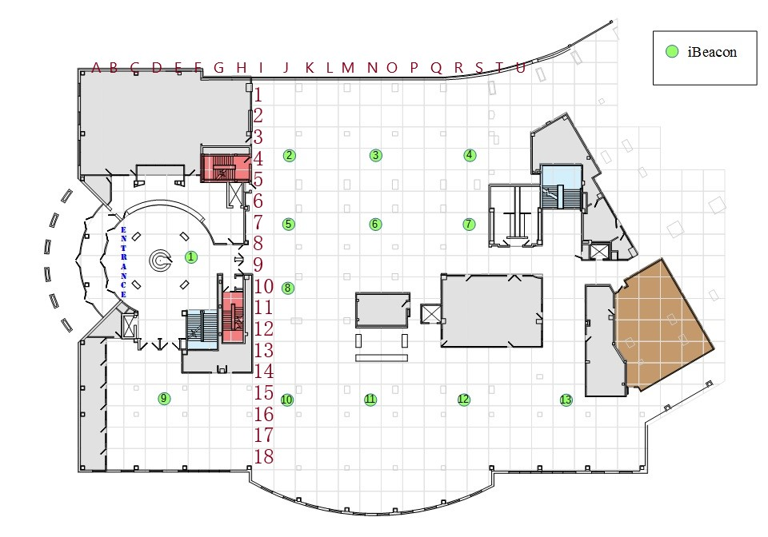
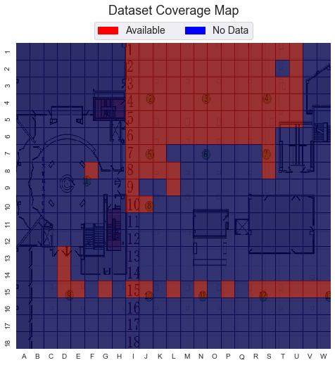
Bluetooth Low-Energy (BLE) RSSI Dataset
Floor layout of the library with locations of the 13 beacons [1]
Coverage of location labels in the dataset
Notes:
Here we see the floor layout of the library and the location of the 13 beacons and we also showed the coverage of available location labels from the dataset which covered only around a quarter of the entire space.

Slide 7
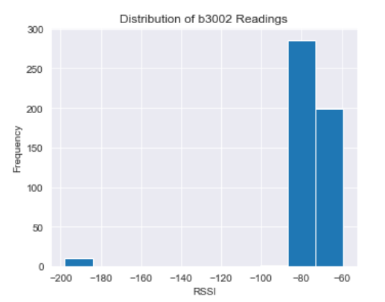
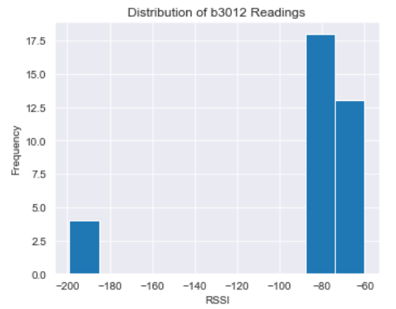
Data Preparation
The dataset was checked for both missing values (NA) and out of bounds readings, i.e. values less than -200 or greater than zero, and all of the beacons had no instances of both.
Outlier RSSI from beacons 2 and 12 were considered erroneous and removed from the analysis.
Outliers
Notes:
For data preparation the dataset was checked for missing values and invalid measurements and all of the beacons had no instances of both. Furthermore, outlier data were also found from beacons 2 and 12 and these were considered as erroneous readings and were removed from the analysis.

Slide 8
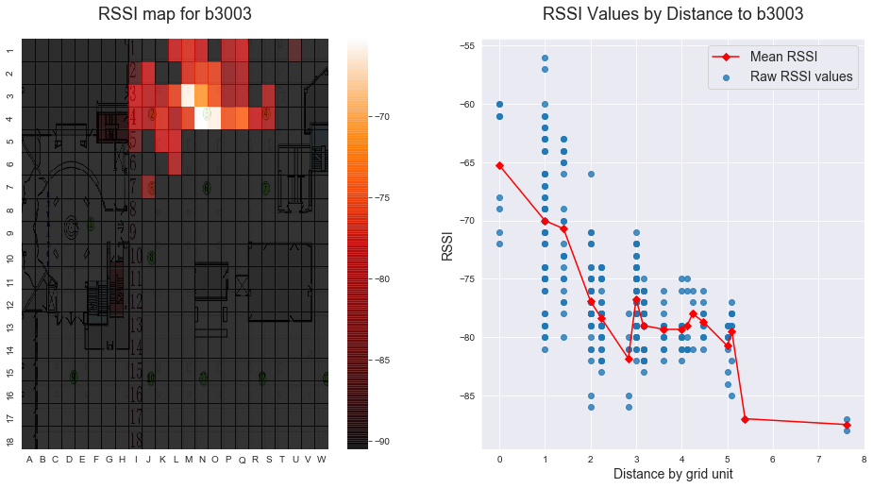
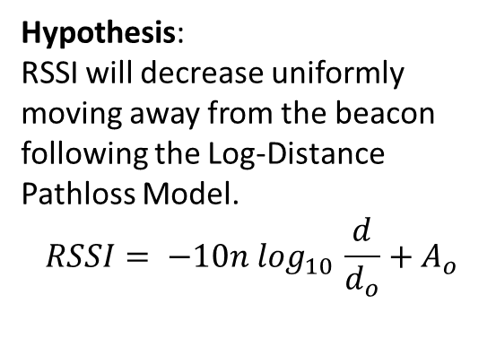
Data Exploration
Hypothesis:
RSSI will decrease uniformly moving away from the beacon following the Log-Distance Pathloss Model.
$$RSSI= −10n \log_{10 }\frac{d}{d_{o}}+A_{o}$$
Propagation of Signal in Space
Observations:
Uneven propagation of the signal
The raw RSSI readings had wide variations for measurements coming from the same distance.
The mean RSSI readings approximated the expected inverse log relationship
Notes:
We also explored the RSSI in relation to space and time. First we looked at the RSSI’s propagation in Space with the hypothesis that RSSI will decrease uniformly moving away from the beacon following the Log-Distance Pathloss Model. And our observations were there was an uneven propagation of the signal and there were wide variations on the raw RSSI readings taken from a specific distance however the mean RSSI was able to approximate the expected inverse log relationship.

Slide 9
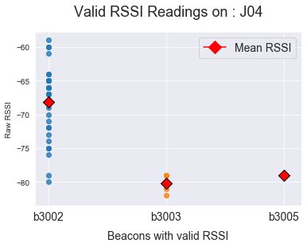
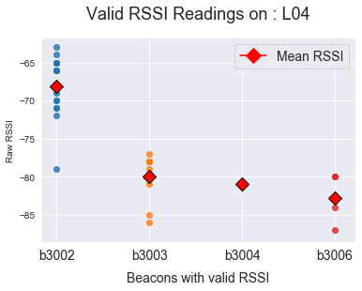
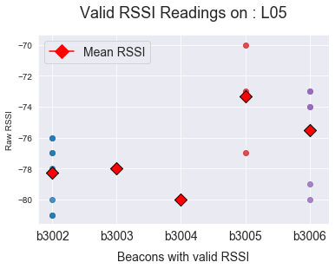
Data Exploration
Valid RSSI Readings on Grid Locations
Hypothesis:
Higher RSSI from beacons closer to the location being inspected
Valid readings will only come from beacons close to the location.
Observation:
Valid signals were only received from beacons close to the location.
Shorter distance did not always translate to higher RSSI.
RSSI variations can be as wide as [-80, -55]
Notes:
Next we looked into valid RSSI on specific grid locations. Here our hypothesis was RSSI from beacons closer to the location will be higher and that valid readings will only come from beacons close to the location. We were able to observe that yes, valid signals were only received from beacons near the location, however, shorter distances did not always translate to higher RSSI.

Slide 10
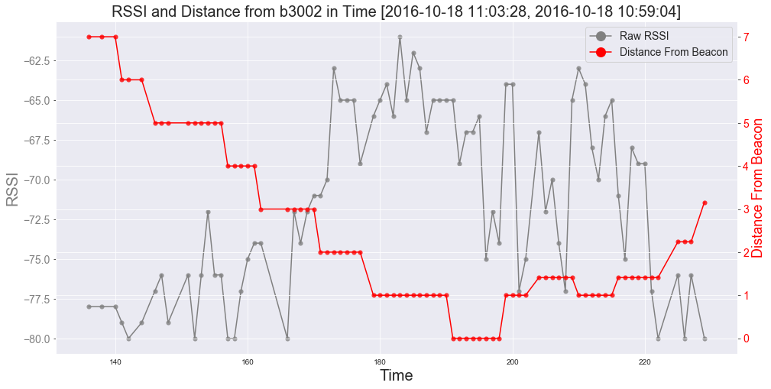
Data Exploration
RSSI and Distance in Time
Hypothesis:
Consecutive valid readings have an association
Observation:
A U-shaped pattern on the distance was observed from most beacons.
The gradual change in the U-shaped pattern show that the datapoints were sequential and represents the speed and direction of the movement of a receiver in reference to a beacon.
Notes:
Lastly, we looked at how RSSI and distance changed over time with the hypothesis that consecutive valid readings have an association. And here we observed a U-shaped pattern on the distance graph for most beacons. So the gradual change in this pattern show that the readings were taken in sequence and it represents the speed and direction of the movement of the receiver in reference to a beacon.

Slide 11
MODELLING
Notes:
Now we proceed to the modelling

Slide 12
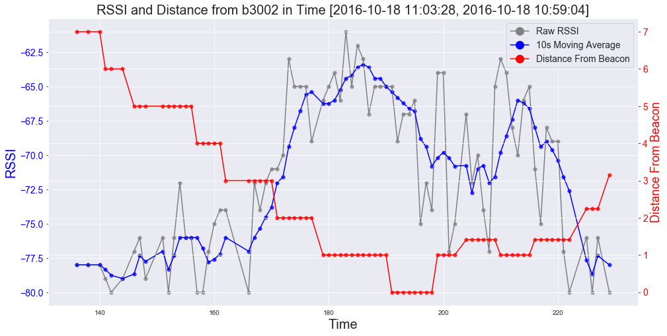
Feature Extraction & Model Selection
Goal: To be able to predict the location (e.g. J04, K12) given a set of RSSI readings from the 13 beacons.
Task: Classification task
Models: K Nearest Neighbors and Decision Tree
Labels: Location labels
Features: Raw RSSI readings and moving average RSSI
Notes:
Again, our goal is to be able to predict the location given a set of RSSI readings from 13 beacons. Our models, as stated earlier, will be KNN and decision tree. And obviously to accomplish this task the location variable will be used as labels.
For the features we use raw RSSI readings and a filtered version of it computed using moving average.

Slide 13
Parameter Tuning and Model Validation
Parameter Tuning: The models were optimized using brute-force approach by testing the performance (mean accuracy) using different combination of parameter values. This was implemented using GridSearchCV library from sklearn.
Algorithm | Parameters Considered | Optimal Parameters
K Nearest Neighbours | Weights - Uniform and distance n_neighbors - From 1 to 10 p – [1,2] | Weights = Uniform or distance n_neighbors = 1 p = 1
Decision Tree | Criterion - Gini or entropy Min_samples_split - From 2 to 10 Mins_samples_leaf - From 2 to 10 | Criterion = Gini Min_samples_split = 2 Mins_samples_leaf = 4
Notes:
We optimized the models using a brute-force approach implemented via GridSearch and the hyperparameters considered and the results of girdsearch are shown in the table

Slide 14
Parameter Tuning and Model Validation
Validation: The models were validate via a 10-fold cross validation with shuffling. The dataset was shuffled due to the unbalanced and sequential nature of the dataset.
Aside from mean accuracy, distance error defined as the Euclidean distance between the predicted label and actual label, was also considered as a metric to assess the models.
Notes:
To validate the model a 10-fold cross validation was done. The data was also shuffled due to the unbalanced and sequential nature of the data.

Slide 15
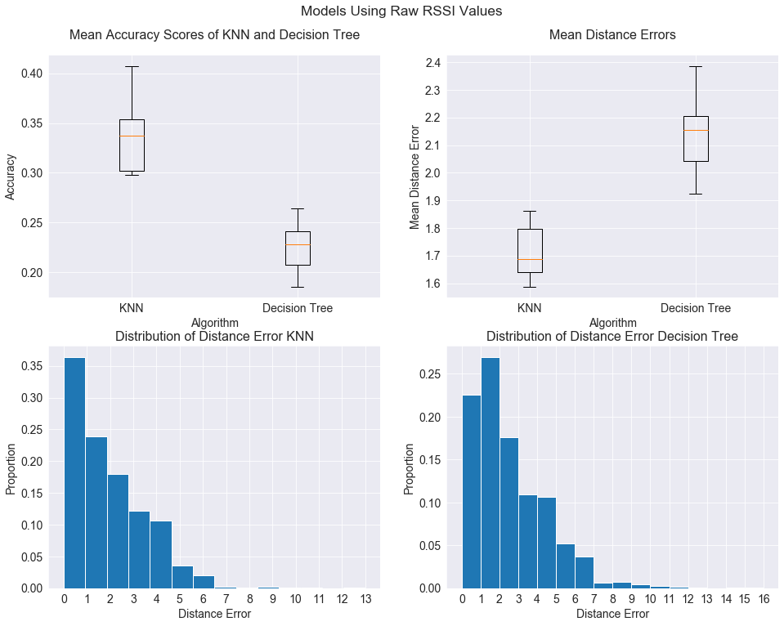
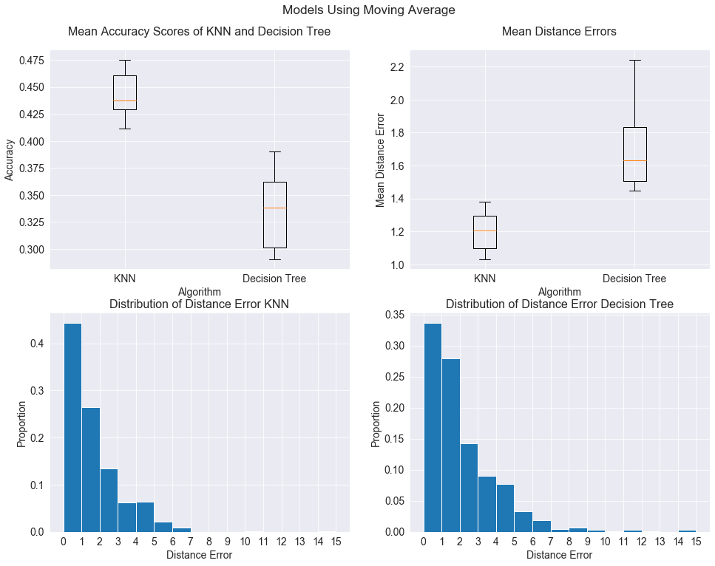
Results
Notes:
Here we show the results of the validation. Some observations: first KNN was able to have higher accuracy than decision tree using both raw RSSI and moving average as feature sets. The distance error presented using histograms gave us a broader view of the performance of our models. We see that some of the models made predictions as far as 15 units away from the correct one. But most of the prediction fall into zero distance or correct prediction except for the decision tree trained using raw RSSI.

Slide 16
Results
Statistic | KNN using Raw RSSI | KNN using moving average | Decision Tree using raw RSSI | Decision Tree using moving average
Min, Max Accuracy | 29.79%, 40.71% | 41.13%, 47.52% | 18.57%, 26.43% | 29.29%, 39.00%
Mean Accuracy | 33.75% | 44.27% | 22.49% | 33.95%
Standard Dev. Acc | 3.78% | 2.12% | 2.58% | 3.64%
Mean Distance Error | 1.72 units | 1.20 units | 2.14 units | 1.69 units
Best Model: KNN with moving average as features with mean accuracy of 44.27% (SD = 2.12%) and mean distance error of 1.20 units.
Worst Model: Decision Tree with raw RSSI as features with mean accuracy of 22.49% (SD = 2.58%) and mean distance error of 2.14 units.
*Using moving average (filtered) RSSI resulted to around 10% increase in mean accuracy for both models
Notes:
The best model was KNN with moving average as features with mean accuracy of 44.27% (SD = 2.12%) and mean distance error of 1.20 units. While worst model was Decision Tree with raw RSSI as feature.

Slide 17
Conclusion
KNN was able to outperform Decision Tree in Bluetooth fingerprinting using RSSI.
Both models had relatively low levels of accuracy and this was probably due to the noise present in the RSSI readings.
The increase in accuracy when the filtered (moving average) RSSI were used as features show the significant effect of noise on the capability of the models to make inference.
The best model created was able to correctly predict the location 43.77% of the time and the predictions were on average 1.20 units away from the correct location.
Since the dataset only contain location labels for around 25% of the area, these models will never be able to correctly predict locations from the other 75%.

